Slide 1
We’ve been crafting beautiful presentation & making clients happy for years.
Machine Learning
for succeeding in
YouTube
Letterpress next level trust fund, before.

Slide 2
Agenda
1. Introduction
YouTube as a marketing and educational platform.
Keyword optimization in increasing video views.
5. Building the ML Model
Data transformation
Log andf MinMaxScaler
ML Models Used
2. What is Machine Learning?
Examples of Machine Learning (ML) in life
6. Results interpretation
How businesses and content creators can leverage this model.
Best ML model
3. ML in YouTube Keyword Analysis
How ML models can predict high-view keywords.
Benefits of using ML for this purpose.
7. Conclusion and Q&A
Key Points
Q&A
4. Dataset
Source
Data cleaning

Slide 3
Introduction
YouTube as a marketing and educational platform.
YouTube is an American online video sharing and social media platform owned by Google.
YouTube enables inexpensive distribution of educational content, including course material from educational institutions and "how to" videos from individuals.
Worldwide video access has spurred innovation by enabling geographically distributed individuals to build upon each other's work, to collaborate, or to crowdsource.

Slide 4
Introduction
Keyword optimization in increasing video views.
In the digital age, YouTube stands as a titan of content, influencing everything from consumer choices to educational paradigms.
The key to harnessing this power lies in keyword optimization.
Keywords help in tailoring a video's reach, ensuring it appears in relevant searches and recommendations, thereby increasing the likelihood of engagement and retention.

Slide 5

What is Machine Learning?
Machine Learning (ML) is about teaching computers to learn from data.
It is much like how we learn from experience.
It's not just a tech buzzword; it's part of our daily lives.
From
Recommendations on Netflix
To voice assistants like Siri
ML is quietly shaping our world.

Slide 6
ML in YouTube Keyword Analysis
In the vast sea of YouTube content standing out requires more than just quality videos.
It's about being seen.
Here's where Machine Learning steps in.
By analyzing patterns in data, ML models can predict which keywords are likely to attract the most viewers.
This isn't just guesswork; it's a data-driven strategy to maximize visibility.

Slide 7

Dataset
2024 Youtube Channels (1 Million)
Source
Dataset, obtained from Kaggle, contains information on 1 million (plus a bit more) YouTube channels.
Channels were picked randomly to extract data.
It includes insights into subscriber counts, total views, total videos, engagement statistics, and more.
Data cleaning
Originally data contained almost 1.1M records, after the process of cleaning there 200K records with enough quality.

Slide 8

Building the ML Model
How ML model was build
In order to optimize ML model, a DataFrame with keywords that have the biggest quantity of views were joined to the clean dataset. To improve ML model on all numeric fields, including target , log function and MinMaxScaler were applied
MinMaxScaler is often used when you need values in a bounded interval. This scaling compresses all inliers in the narrow range (in the presence of outliers).
A variety of ML Models were tested, like
XGBoostRegressor | LinearRegression | DecisionTreeRegressor
CatBoostRegressor | Ridge | Tensorflow
Notes:
When to Combine Log Transformation with MinMaxScaler
Algorithm Requirements: Many machine learning algorithms perform best when the feature data is scaled to a specific range, typically [0, 1] or [-1, 1]. For example, gradient descent-based algorithms benefit from all features being on a similar scale because it helps the algorithm converge more quickly. Neural networks also often require input data scaled to [0,1] or [-1,1].
Preserving Shape Post-Transformation: After applying a log transformation, applying a MinMaxScaler can be useful to ensure all features are strictly within the same range. This is particularly important when different features have different units or scales.
Maintaining Consistency Across Features: When features are transformed differently, it might introduce a bias towards those features scaled differently. Uniform scaling ensures that all input features contribute equally to the analysis.
Example: In a dataset where some features vary within a small range while others vary widely because they include exponential growth, applying a log transformation first to reduce scale variations and then applying MinMaxScaler can make the dataset suitable for algorithms like Support Vector Machines or Neural Networks.

Slide 9
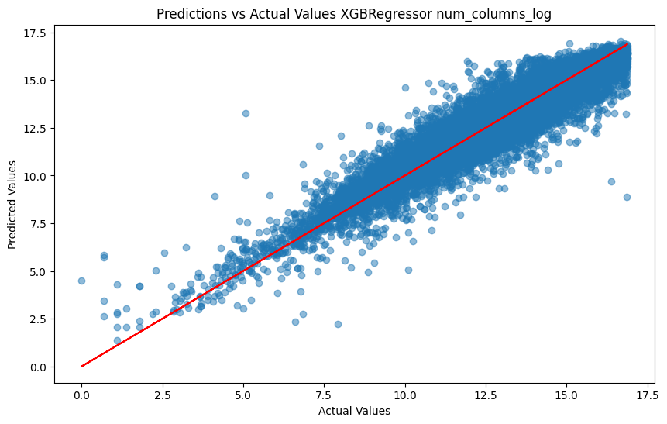
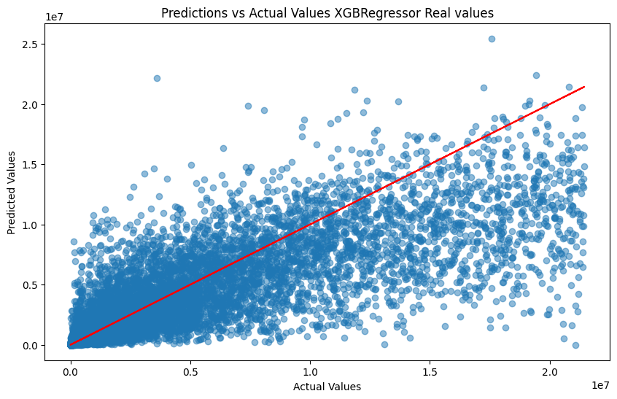
Results interpretation
While the benefits of using ML for keyword prediction are clear, it's important to navigate the challenges responsibly.
How businesses and content creators can leverage this model.
The dynamic nature of online content should be considered.
What works today might not work tomorrow, so continuous learning is key.
Best ML model (XGBRegressor)
Here the plot with normalized values and with real values
Notes:
Excerpt from
https://www.kaggle.com/discussions/product-feedback/164183
**There are four assumptions associated with a linear regression model:**
*1-Linearity*: The relationship between X and the mean of Y is linear.
*2-Homoscedasticity*: The variance of residual is the same for any value of X.
*3-Independence*: Observations are independent of each other.
*4-Normality*: For any fixed value of X, Y is normally distributed
*Skewness* is a measure of the symmetry in a distribution. A symmetrical data set will have a skewness equal to 0. So, a normal distribution will have a skewness of 0. Skewness essentially measures the relative size of the two tails.
so that been said ,the objective of choosing features with *skewed_feats>0.75* is because we are searching to work with features that have a more normal-like distribution so this why we apply a log transformation so to normalize the distribution ( skewness =0) cause models cause linear models work better on or normalized data. well to be more specific it's a good practice to always normalize your features.
**Transformations**
In data analysis transformation is the replacement of a variable by a function of that variable. Example replacing a variable x by the square root of x or the logarithm of x.
**Reasons for using transformations**
*Convenience*: A transformed scale may be as natural as the original scale and more convenient for a specific purpose (e.g. percentages rather than original data, sines rather than degrees). One important example is standardization.
*Reducing skewness*: A transformation may be used to reduce skewness. A distribution that is symmetric or nearly so is often easier to handle and interpret than a skewed distribution. To reduce right skewness, take roots or logarithms or reciprocals (roots are weakest). This is the commonest problem in practice. To reduce left skewness, take squares or cubes or higher powers.
*Equal spreads*: A transformation may be used to produce approximately equal spreads, despite marked variations in level, which again makes data easier to handle and interpret.
*Linear relationships*: When looking at relationships between variables, it is often far easier to think about patterns that are approximately linear than about patterns that are highly curved.
*Additive relationships*: Relationships are often easier to analyse when additive rather than multiplicative.
**Logarithm**
The logarithm, x to log base 10 of x, or x to log base e of x (ln x), or x to log base 2 of x, is a strong transformation with a major effect on distribution shape. It is commonly used for reducing right skewness and is often appropriate for measured variables. It can not be applied to zero or negative values. One unit on a logarithmic scale means a multiplication by the base of logarithms being used.

Slide 10
Conclusion and Q&A
Content creation on 2024
YouTube stands as a titan of content, influencing everything from consumer choices to educational paradigms.
The key to harnessing this power lies in keyword optimization.
How to succeed
In a landscape crowded with content, keyword optimization is not just a strategy, but a necessity for standing out.
With our solution you can do it

Slide 11
Thanks for your time
jorgegmayorgas@gmail.com

